Slide 1
BT 205: Cell & Molecular Biology
-Prof. Siddhartha Sankar Ghosh

Slide 2
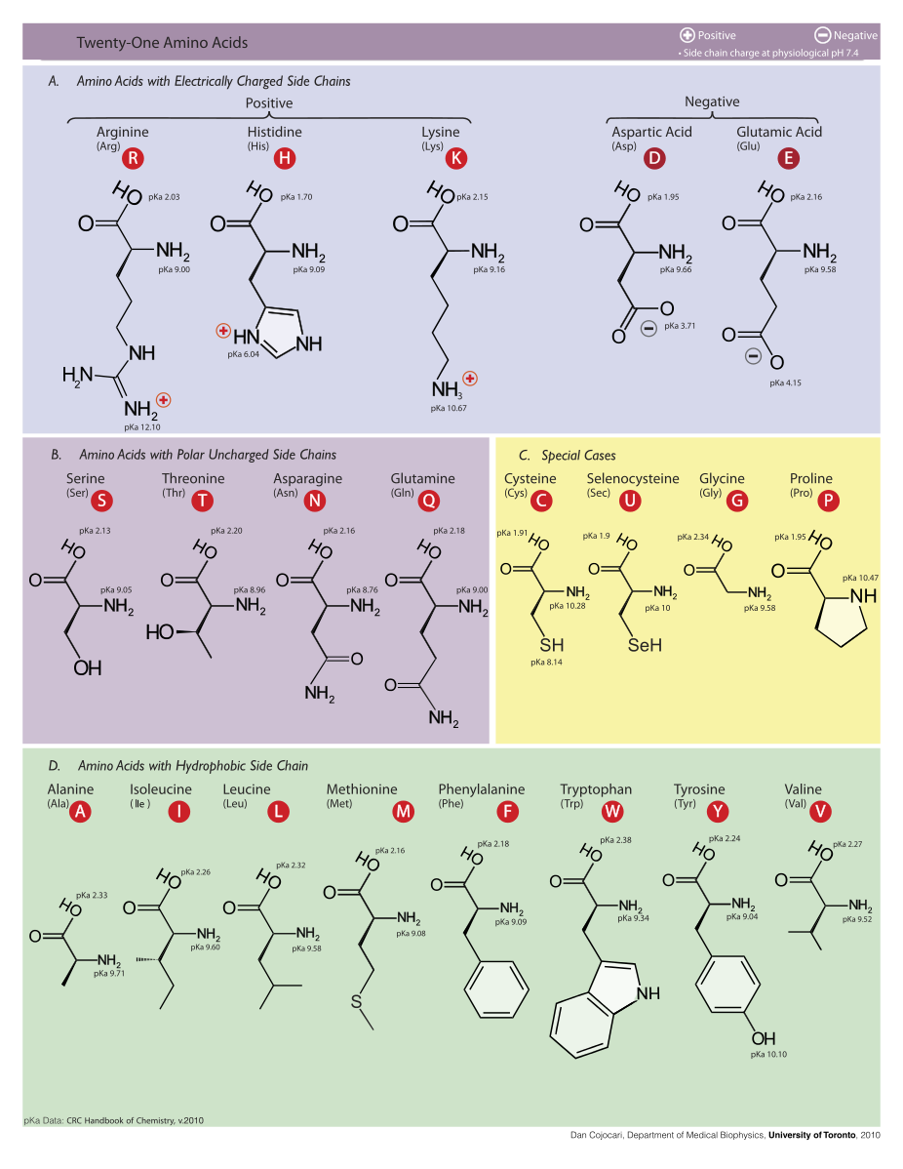
20 Amino Acids

Slide 3
Amino acids
In 1806, French chemists Louis-Nicolas Vauquelin and Pierre Jean Robiquet isolated a compound from asparagus that was subsequently named asparagine, the first amino acid to be discovered.
Cystine was discovered in 1810
Glycine and leucine were discovered in 1820.
The last of the 20 common amino acids to be discovered was threonine in 1935 by William Cumming Rose, who also determined the essential amino acids and established the minimum daily requirements of all amino acids for optimal growth.
Proteins were found to yield amino acids after enzymatic digestion or acid hydrolysis.
In 1902, Emil Fischer and Franz Hofmeister independently proposed that proteins are formed from many amino acids, whereby bonds are formed between the amino group of one amino acid with the carboxyl group of another, resulting in a linear structure that Fischer termed "peptide".

Slide 4
Origin of Genetic Code
A polypeptide of 100 residues is synthesized in an Escherichia coli cell (at 37 °C) in about 5 seconds.
Synthesis of the thousands of different proteins in a cell is tightly regulated, so that just enough copies are made to match the current metabolic circumstances

Slide 5
The First key Advance
First, in the early 1950s, Paul Zamecnik and his colleagues designed a set of experiments to investigate where in the cell proteins are synthesized.
They injected radioactive amino acids into rats and, at different time intervals after the injection, removed the liver, homogenized it, fractionated the homogenate by centrifugation, and examined the subcellular fractions for the presence of radioactive protein.
When hours or days were allowed to elapse after injection of the labeled amino acids, all the subcellular fractions contained labeled proteins.
However, when only minutes had elapsed, labeled protein appeared only in a fraction containing small ribonucleoprotein particles.
These particles, visible in animal tissues by electron microscopy, were therefore identified as the site of protein synthesis from amino acids, and later were named ribosomes

Slide 6
Ribosomes and endoplasmic reticulum
Electron micrograph and schematic drawing of a portion of a pancreatic cell, showing ribosomes attached to the outer (cytosolic) face of the endoplasmic reticulum (ER).

Slide 7
The Second Key Advance
The second key advance was made by Mahlon Hoagland and Zamecnik when they found that amino acids were “activated” for protein synthesis when incubated with ATP and the cytosolic fraction of liver cells.
The amino acids became attached to a heat-stable soluble RNA of the type that had been discovered and characterized by Robert Holley, and later called transfer RNA (tRNA), to form aminoacyl-tRNAs.
The enzymes that catalyze this process are the aminoacyl-tRNA synthetases.

Slide 8
The Third Key Advance
The third advance resulted from Francis Crick’s reasoning on how the genetic information encoded in the 4-letter language of nucleic acids could be translated into the 20-letter language of proteins.
A small nucleic acid (perhaps an RNA) could serve the role of an adaptor, with one part of the adaptor molecule binding a specific amino acid and another part recognizing the nucleotide sequence encoding that amino acid in an mRNA. This idea was soon verified.
The tRNA adaptor, the same molecule that activates the amino acid for peptide bond formation, also “translates” the nucleotide sequence of an mRNA into the amino acid sequence of a polypeptide.
The overall process of mRNA-guided protein synthesis is often referred to simply as translation

Slide 9
The Genetic Code Was Cracked Using Artificial mRNA Templates
By the 1960s, it was apparent that at least three nucleotide residues of DNA are necessary to encode each amino acid. The four code letters of DNA (A, T, G, and C) in groups of two can yield only 4² = 16 different combinations, insufficient to encode 20 amino acids. Groups of three, however, yield 4³ = 64 different combinations.

Slide 10
Crick’s adaptor hypothesis. Today we know that the amino acid is covalently bound at the 3′ end of a tRNA molecule and that a specific nucleotide triplet elsewhere in the tRNA interacts with a particular triplet codon in mRNA through hydrogen bonding of complementary bases.

Slide 11
A key question remained: what were the three-letter code words for each amino acid?
In 1961, Marshall Nirenberg and Heinrich Matthaei reported the first breakthrough.
They incubated synthetic polyuridylate, poly(U), with an E. coli extract, GTP, ATP, and a mixture of the 20 amino acids in 20 different tubes, each tube containing a different radioactively labeled amino acid.
Because poly(U) mRNA is made up of many successive UUU triplets, it should promote the synthesis of a polypeptide containing only the amino acid encoded by UUU.
A radioactive polypeptide was indeed formed in only one of the 20 tubes, the one containing radioactive phenylalanine.
Nirenberg and Matthaei therefore concluded that the triplet codon UUU encodes phenylalanine.
The same approach soon revealed that polycytidylate, poly(C), encodes a polypeptide containing only proline (polyproline), and polyadenylate, poly(A), encodes polylysine.
# Exception: Polyguanylate did not generate any polypeptide in this experiment because it spontaneously forms tetraplexes that cannot be bound by ribosomes.

Slide 12
The triplet, non-overlapping code

Slide 13
Early experiments designed to elucidate the genetic code.
A synthetic RNA containing only A and C residues in 5:1 ratio directed polypeptide synthesis, and both the identity and the quantity of incorporated amino acids were determined.
Based on the relative abundance of A and C residues in the synthetic RNA, and assigning the codon AAA (the most likely codon) a frequency of 100, there should be three different codons of composition A2 C, each at a relative frequency of 20; three of composition AC2 , each at a relative frequency of 4.0; and CCC at a relative frequency of 0.8.
The CCC assignment was based on information derived with poly (C). Where two tentative codon assignments are made, both are proposed to code for the same amino acid. These designations of nucleotide composition contain no information on nucleotide sequence (except, of course, AAA and CCC).

Slide 14
Incorporation of Amino Acids into Polypeptides in Response to Random Polymers of RNA

Slide 16
Discovery of H. Gobind Khorana
At about this time, a complementary approach was provided by H. Gobind Khorana, who developed chemical methods to synthesize polyribonucleotides with defined, repeating sequences of two to four bases.
The polypeptides produced by these mRNAs had one or a few amino acids in repeating patterns.
These patterns, when combined with information from the random polymers used by Nirenberg and colleagues, permitted unambiguous codon assignments.
The copolymer (AC)n, for example, has alternating ACA and CAC codons: ACACACACACACACA. The polypeptide synthesized on this messenger contained equal amounts of threonine and histidine.
Given that a histidine codon has one A and two Cs, CAC must code for histidine and ACA for threonine.

Slide 18
THANK YOU

